Slide 1
Overview slides
1 October 2025

Slide 2


Datasets
Hosted portals
114,614
55
Country Participants
66
Peer-review papers
using data (1 July 2025)
13,615
Organizational Participants
Average records
downloaded per month (2025)
42
273.0 billion
Species
occurrence records
Publishers
2,565
3,511,110,544
By the numbers | 1 October 2025
www.gbif.org

Slide 3
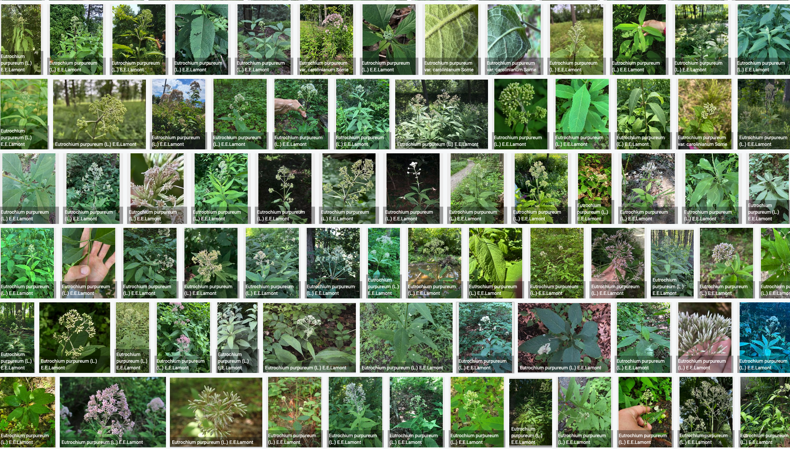
Species occurrence records with multimedia evidence
1 October 2025
254.0 million records with taxonomically identified images
171.6 million human observations
72.1 million specimens
7.1 million material samples
1.5 million fossil specimens
1,787,956 audio files
5,369 videos
https://www.gbif.org/occurrence/gallery

Slide 4
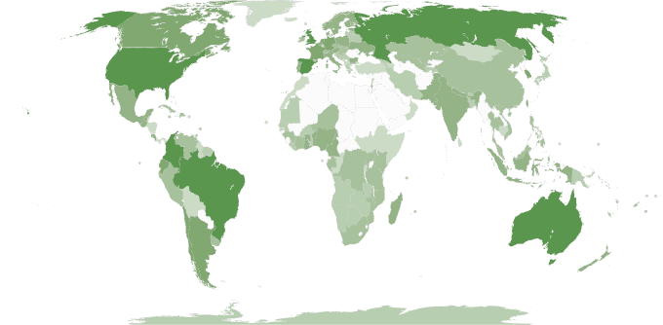
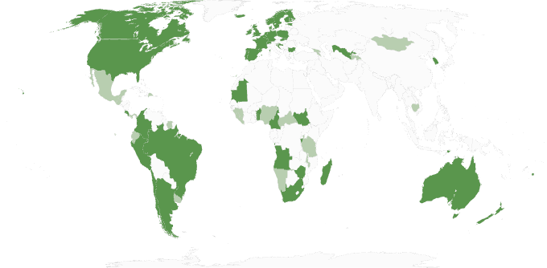
GBIF Participant countries
1 October 2025
Voting Participants
Associate Participants

Slide 5
GBIF network of data publishing institutions
1 October 2025
148
countries/areas with institutions
sharing data through GBIF
Number of active publishers by country or area

Slide 6
GBIF.org traffic by country: 2025
1 October 2025
Rank | Country/Territory | Visitors | Visits | Effective visits* | % Effective visits | 2024 rank | Pages / visit
1 | China | 1,374,771 | 2,882,465 | 317,071 | 9.43 % | 7 | 2.59
2 | United States | 642,544 | 741,140 | 311,279 | 9.26 % | 1 | 4.54
3 | Colombia | 284,815 | 359,809 | 176,306 | 5.24 % | 2 | 5.27
4 | France | 346,530 | 407,129 | 162,852 | 4.84 % | 5 | 4.40
5 | Indonesia | 214,016 | 259,330 | 155,598 | 4.63 % | 3 | 6.48
6 | Brazil | 268,589 | 315,878 | 154,780 | 4.60 % | 8 | 5.22
7 | Spain | 227,378 | 283,971 | 147,655 | 4.39 % | 4 | 6.30
8 | Germany | 254,584 | 306,506 | 140,993 | 4.19 % | 9 | 5.57
9 | Mexico | 211,825 | 249,898 | 114,953 | 3.42 % | 6 | 4.90
10 | India | 208,902 | 233.323 | 97,996 | 2.19 % | 10 | 4.44
 | TOTAL | 7,287,740 | 9,890,030 | 3,362,882 | 100.00% |  | 4.28

Slide 7
Occurrences published by country: 2025
1 October 2025
Rank | Country/Territory | 2025 | 2024 total | 2024 rank
1 | United States | 195,295,350 | 158,323,610 | 1
2 | Australia | 51,587,057 | 14,003,238 | 6
3 | United Kingdom | 42,163,946 | 12,938,043 | 7
4 | Belgium | 34,762,028 | 5,800,027 | 13
5 | Canada | 30,672,153 | 22,530,128 | 5
6 | Norway | 24,861,909 | 4,061,537 | 17
7 | Netherlands | 17,939,048 | 25,251,786 | 4
8 | Sweden | 12,823,711 | 25,696,307 | 3
9 | India | 12,823,711 | 14,003,238 | 8
10 | France | 11,488,380 | 43,910,491 | 2
OTHER COUNTRIES + AREAS | OTHER COUNTRIES + AREAS | 105,662,680 | 97,322,395
TOTAL |  | 539,518,907 | 428,451,251

Slide 8
Data download requests by country: 2025
1 October 2025
Rank | Country |  | 2025 | 2024 total | 2024 rank
1 | China | 50,615 |  | 63,485 | 1
2 | United States | 35,135 |  | 41,921 | 2
3 | Mexico | 20,946 |  | 29,712 | 3
4 | Colombia | 17,247 |  | 21,247 | 5
5 | Brazil | 15,734 |  | 21,641 | 4
6 | Spain | 12,023 |  | 14,704 | 6
7 | United Kingdom | 10,405 |  | 13,502 | 7
8 | Germany | 8,471 |  | 8,558 | 10
9 | France | 6,795 |  | 7,248 | 9
10 | Canada | 6,510 |  | 8,946 | 8
OTHER COUNTRIES + AREAS | ALL OTHERS | 99,342 |  | 115,002
TOTAL |  | 283,223 |  | 347,717
172
countries, islands & territories where users have ≥5 requested downloads in 2025
Notes:
DOWNLOAD ADJUSTMENTS FOR USERS ≥500 DOWNLOADS FOR JAN-SEPT 2025: AT (1) 2084; AU (1): 961; BE (2): 1440; BR (7): 14717; CA (2): 1358; CH (2): 2474; CN (18): 33554; CZ (2): 2308; DE (4): 2552 ; DK (2): 5583; ES (3): 4034; FR (2): 1597; GB (15): 171162; HR (1): 1977; IL (2) 4302; IN (1): 667; IT (3): 3047; JP (2) 4676; KR (2): 8477; MO (1): 2163; MX (3): 7919; NL (3): 7755; PT (2): 1508; RO (1): 559; TH (1): 1583; TW (1) 2947; US (18): 42321; ZA (2): 31504

Slide 9
Peer-reviewed publications using GBIF-mediated data
1 July 2025

Slide 10
Data use in peer-reviewed journals: 2025
1 July 2025
Peer-reviewed uses by country
Peer-reviewed uses by region
End of Year |  |  | 2025 total | 2024 total | 2024 rank
1 | China |  | 386 | 529 | 1
2 | United States |  | 273 | 486 | 2
3 | United Kingdom |  | 112 | 186 | 5
4 | Brazil |  | 113 | 238 | 3
5 | Germany |  | 98 | 186 | 6
6 | Spain |  | 80 | 171 | 7
7 | Canada |  | 64 | 100 | 11
8 | Mexico |  | 63 | 186 | 4
9 | Australia |  | 59 | 104 | 10
10 | India |  | 56 | 78 | 12

Slide 11


Suggestions reviewed
Institutions
8,787
2,766
vv
Countries
Collections
125
10,158
Country editors
Digitized specimens
68
248,566,791
GRSciColl by the numbers | 25 August 2025
scientific-collections.gbif.org
Notes:
Our community of editors is doing a huge work to update GRSciColl. In 2024 alone, more than 1600 entries were added to GRSciColl. At the core of the GRSciColl work are our Nodes and the GBIF Regional support teams which have been working on reaching out to institutions in GRSciColl as an entry point to sharing GBIF data.

Slide 12




Hosted portals update
13
GBIF national Participants and regions
8
Institutional
56
Hosted portals in production
8
27
Networks/thematic networks
Scientific journal

Slide 13
Metabarcoding data programme
47
44,024,062
20
Datasets
Records
Installations
gbif.org/metabarcoding
Notes:
Notes

Slide 15
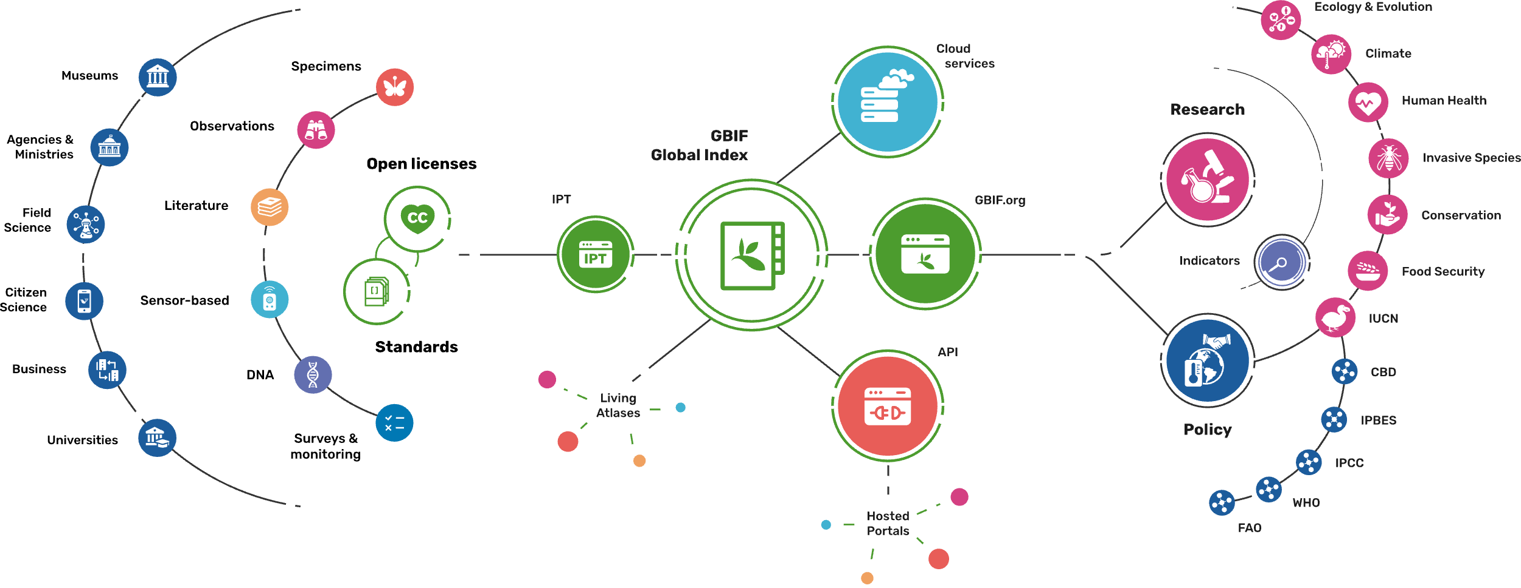
Providing biodiversity evidence for research and policy

Slide 16
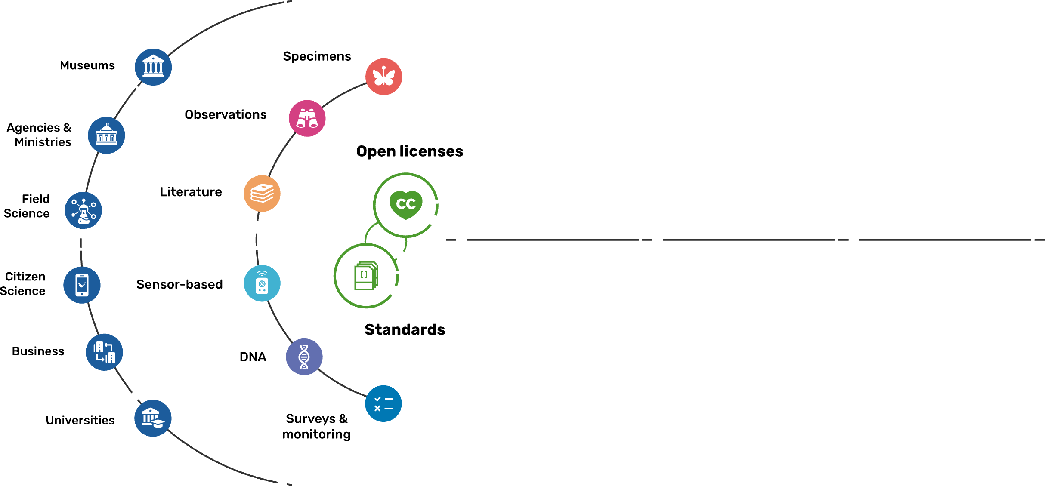
Sources of biodiversity evidence
Create
Combine sources of evidence

Slide 17
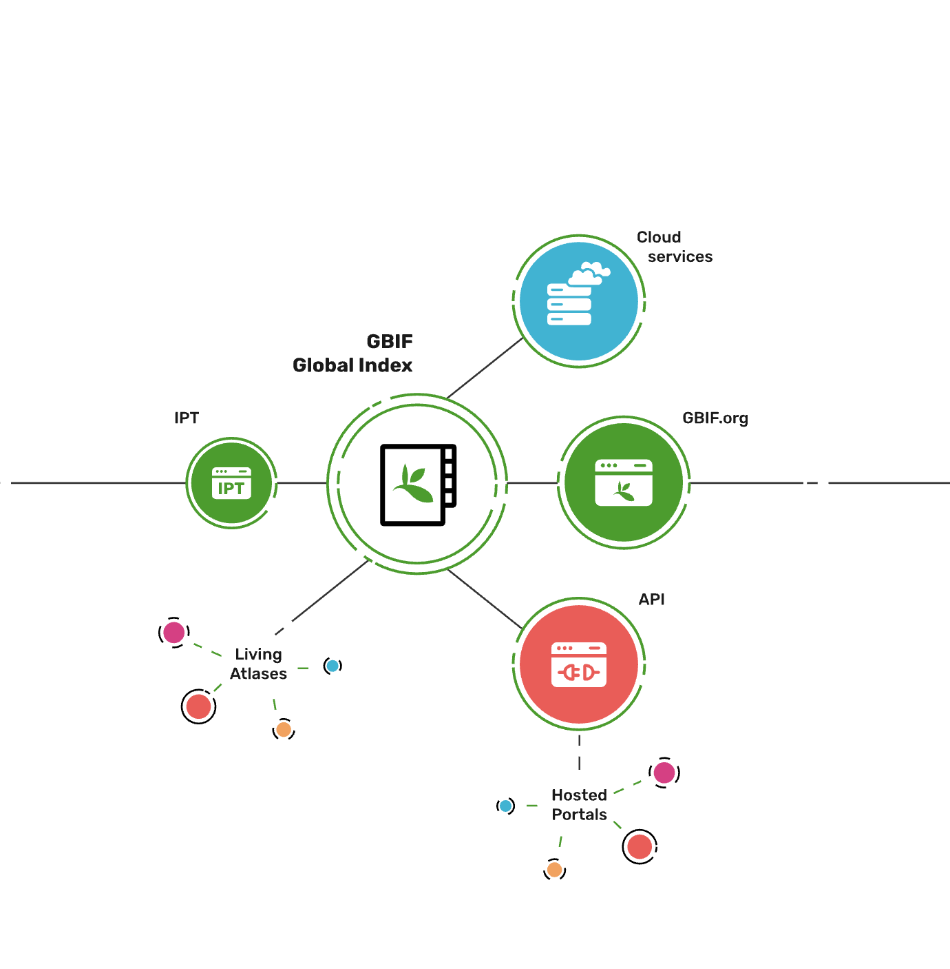
Access to biodiversity evidence
Share
FAIR and open access

Slide 18
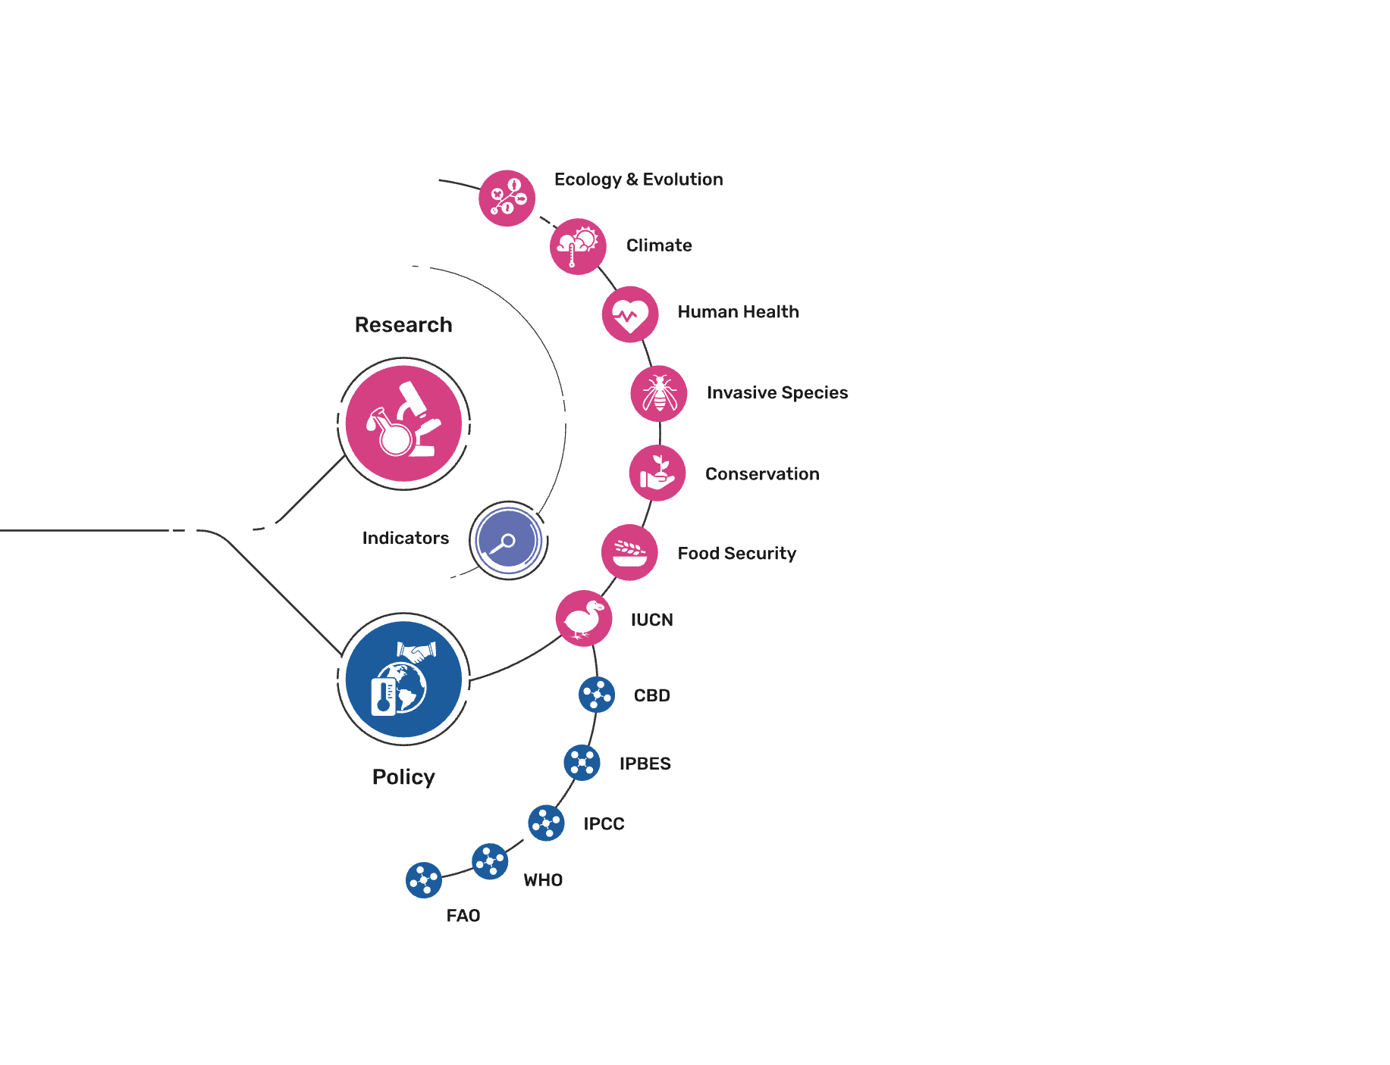
Uses of biodiversity evidence
Transform
Apply and use data

